Slide 1

Business Intelligence: Data Warehousing, Data Acquisition, Data Mining, Business Analytics, and Visualization
Dibya Tara Shakya
5-<number>

Slide 2
Data, Information, Knowledge
Data
  Items that are the most elementary descriptions of things, events, activities, and transactions
  May be internal or external
Information
  Organized data that has meaning and value
Knowledge
  Processed data or information that conveys understanding or learning applicable to a problem or activity
© 2005 Prentice Hall, Decision Support Systems and Intelligent Systems, 7th Edition, Turban, Aronson, and Liang
5-<number>

Slide 3
Data
Raw data collected manually or by instruments
Quality is critical
  Quality determines usefulness
    Contextual data quality
    Intrinsic data quality
    Accessibility data quality
    Representation data quality
  Often neglected or casually handled
  Problems exposed when data is summarized
© 2005 Prentice Hall, Decision Support Systems and Intelligent Systems, 7th Edition, Turban, Aronson, and Liang
5-<number>

Slide 4
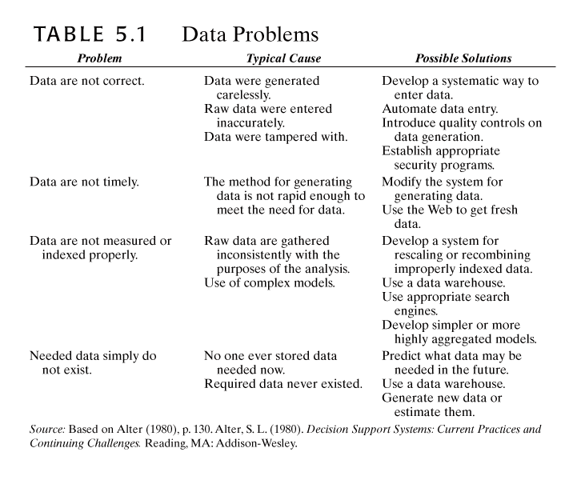
© 2005 Prentice Hall, Decision Support Systems and Intelligent Systems, 7th Edition, Turban, Aronson, and Liang
5-<number>

Slide 5
Data
Cleanse data
  When populating warehouse
  Data quality action plan
  Best practices for data quality
  Measure results
Data integrity issues
  Uniformity
  Version
  Completeness check
  Conformity check
  Genealogy or drill-down
© 2005 Prentice Hall, Decision Support Systems and Intelligent Systems, 7th Edition, Turban, Aronson, and Liang
5-<number>

Slide 6
Data
Data Integration
Access needed to multiple sources
  Often enterprise-wide
  Disparate and heterogeneous databases
  XML becoming language standard
© 2005 Prentice Hall, Decision Support Systems and Intelligent Systems, 7th Edition, Turban, Aronson, and Liang
5-<number>

Slide 7
External Data Sources
Web
  Intelligent agents
  Document management systems
  Content management systems
Commercial databases
  Sell access to specialized databases
© 2005 Prentice Hall, Decision Support Systems and Intelligent Systems, 7th Edition, Turban, Aronson, and Liang
5-<number>

Slide 8
Database Management Systems
Software program
Supplements operating system
Manages data
Queries data and generates reports
Data security
Combines with modeling language for construction of DSS
© 2005 Prentice Hall, Decision Support Systems and Intelligent Systems, 7th Edition, Turban, Aronson, and Liang
5-<number>

Slide 9
Database Models
Hierarchical
  Top down, like inverted tree
  Fields have only one “parent”, each “parent” can have multiple “children”
  Fast
Network
  Relationships created through linked lists, using pointers
  “Children” can have multiple “parents”
  Greater flexibility, substantial overhead
Relational
  Flat, two-dimensional tables with multiple access queries
  Examines relations between multiple tables
  Flexible, quick, and extendable with data independence
Object oriented
  Data analyzed at conceptual level
  Inheritance, abstraction, encapsulation
© 2005 Prentice Hall, Decision Support Systems and Intelligent Systems, 7th Edition, Turban, Aronson, and Liang
5-<number>

Slide 10
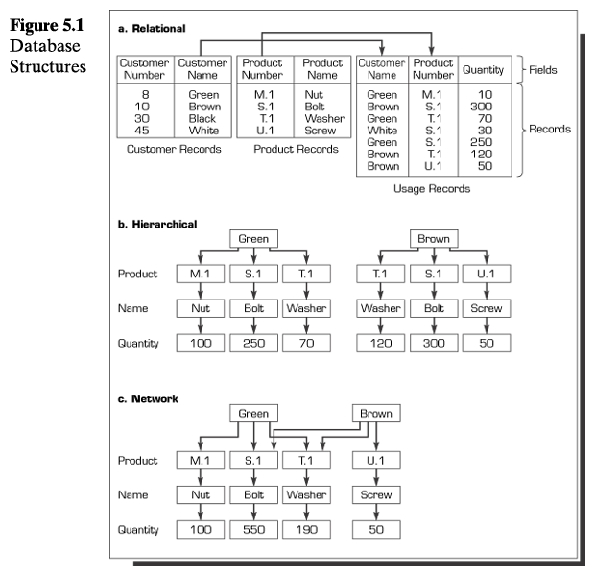
© 2005 Prentice Hall, Decision Support Systems and Intelligent Systems, 7th Edition, Turban, Aronson, and Liang
5-<number>

Slide 11
Database Models, continued
Multimedia Based
  Multiple data formats
    JPEG, GIF, bitmap, PNG, sound, video, virtual reality
  Requires specific hardware for full feature availability
Document Based
  Document storage and management
Intelligent
  Intelligent agents and ANN
    Inference engines
© 2005 Prentice Hall, Decision Support Systems and Intelligent Systems, 7th Edition, Turban, Aronson, and Liang
5-<number>

Slide 12
Data Warehouse
Subject oriented
Scrubbed so that data from heterogeneous sources are standardized
Time series; no current status
Nonvolatile
  Read only
Summarized
Not normalized; may be redundant
Data from both internal and external sources is present
Metadata included
  Data about data
    Business metadata
    Semantic metadata
© 2005 Prentice Hall, Decision Support Systems and Intelligent Systems, 7th Edition, Turban, Aronson, and Liang
5-<number>

Slide 13
Architecture
May have one or more tiers
  Determined by warehouse, data acquisition (back end), and client (front end)
    One tier, where all run on same platform, is rare
    Two tier usually combines DSS engine (client) with warehouse
      More economical
    Three tier separates these functional parts
© 2005 Prentice Hall, Decision Support Systems and Intelligent Systems, 7th Edition, Turban, Aronson, and Liang
5-<number>

Slide 14
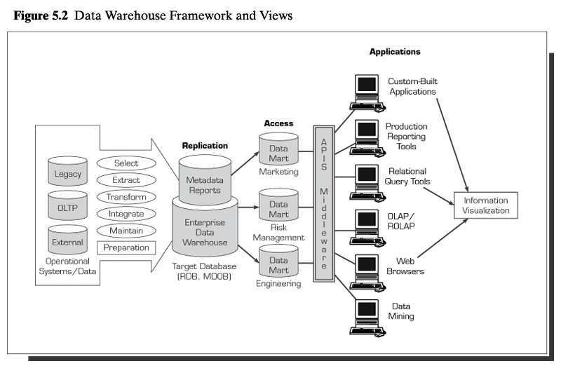
© 2005 Prentice Hall, Decision Support Systems and Intelligent Systems, 7th Edition, Turban, Aronson, and Liang
5-<number>

Slide 15
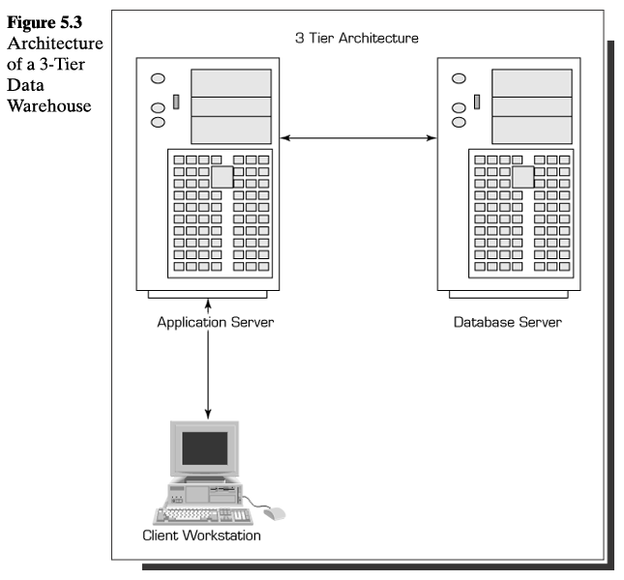
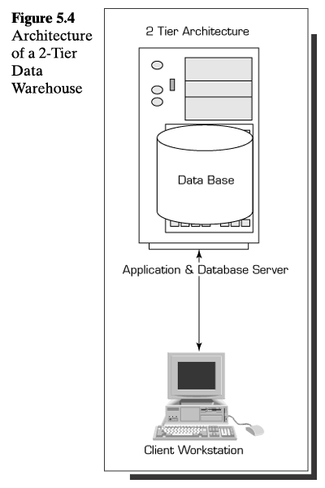
© 2005 Prentice Hall, Decision Support Systems and Intelligent Systems, 7th Edition, Turban, Aronson, and Liang
5-<number>

Slide 16
Migrating Data
Business rules
  Stored in metadata repository
  Applied to data warehouse centrally
Data extracted from all relevant sources
  Loaded through data-transformation tools or programs
  Separate operation and decision support environments
Correct problems in quality before data stored
  Cleanse and organize in consistent manner
© 2005 Prentice Hall, Decision Support Systems and Intelligent Systems, 7th Edition, Turban, Aronson, and Liang
5-<number>

Slide 17
Data Warehouse Design
Dimensional modeling
  Retrieval based
  Implemented by star schema
    Central fact table
    Dimension tables
Grain
  Highest level of detail
  Drill-down analysis
© 2005 Prentice Hall, Decision Support Systems and Intelligent Systems, 7th Edition, Turban, Aronson, and Liang
5-<number>

Slide 18
Data Warehouse Development
Data warehouse implementation techniques
  Top down
  Bottom up
  Hybrid
  Federated
Projects may be data centric or application centric
Implementation factors
  Organizational issues
  Project issues
  Technical issues
Scalable
Flexible
© 2005 Prentice Hall, Decision Support Systems and Intelligent Systems, 7th Edition, Turban, Aronson, and Liang
5-<number>

Slide 19
Data Marts
Dependent
  Created from warehouse
  Replicated
    Functional subset of warehouse
Independent
  Scaled down, less expensive version of data warehouse
  Designed for a department or SBU
  Organization may have multiple data marts
    Difficult to integrate
© 2005 Prentice Hall, Decision Support Systems and Intelligent Systems, 7th Edition, Turban, Aronson, and Liang
5-<number>

Slide 20
Business Intelligence and Analytics
Business intelligence
  Acquisition of data and information for use in decision-making activities
Business analytics
  Models and solution methods
Data mining
  Applying models and methods to data to identify patterns and trends
© 2005 Prentice Hall, Decision Support Systems and Intelligent Systems, 7th Edition, Turban, Aronson, and Liang
5-<number>

Slide 21
OLAP
Activities performed by end users in online systems
  Specific, open-ended query generation
    SQL
  Ad hoc reports
  Statistical analysis
  Building DSS applications
Modeling and visualization capabilities
Special class of tools
  DSS/BI/BA front ends
  Data access front ends
  Database front ends
  Visual information access systems
© 2005 Prentice Hall, Decision Support Systems and Intelligent Systems, 7th Edition, Turban, Aronson, and Liang
5-<number>

Slide 22
Data Mining
Organizes and employs information and knowledge from databases
Statistical, mathematical, artificial intelligence, and machine-learning techniques
Automatic and fast
Tools look for patterns
  Simple models
  Intermediate models
  Complex Models
© 2005 Prentice Hall, Decision Support Systems and Intelligent Systems, 7th Edition, Turban, Aronson, and Liang
5-<number>

Slide 23
Data Mining
Data mining application classes of problems
  Classification
  Clustering
  Association
  Sequencing
  Regression
  Forecasting
  Others
Hypothesis or discovery driven
Iterative
Scalable
© 2005 Prentice Hall, Decision Support Systems and Intelligent Systems, 7th Edition, Turban, Aronson, and Liang
5-<number>

Slide 24
Tools and Techniques
Data mining
  Statistical methods
  Decision trees
  Case based reasoning
  Neural computing
  Intelligent agents
  Genetic algorithms
Text Mining
  Hidden content
  Group by themes
  Determine relationships
© 2005 Prentice Hall, Decision Support Systems and Intelligent Systems, 7th Edition, Turban, Aronson, and Liang
5-<number>

Slide 25
Knowledge Discovery in Databases
Data mining used to find patterns in data
  Identification of data
  Preprocessing
  Transformation to common format
  Data mining through algorithms
  Evaluation
© 2005 Prentice Hall, Decision Support Systems and Intelligent Systems, 7th Edition, Turban, Aronson, and Liang
5-<number>

Slide 26
Data Visualization
Technologies supporting visualization and interpretation
  Digital imaging, GIS, GUI, tables, multidimensions, graphs, VR, 3D, animation
  Identify relationships and trends
Data manipulation allows real time look at performance data
© 2005 Prentice Hall, Decision Support Systems and Intelligent Systems, 7th Edition, Turban, Aronson, and Liang
5-<number>

Slide 27
Multidimensionality
Data organized according to business standards, not analysts
Conceptual
Factors
  Dimensions
  Measures
  Time
Significant overhead and storage
Expensive
Complex
© 2005 Prentice Hall, Decision Support Systems and Intelligent Systems, 7th Edition, Turban, Aronson, and Liang
5-<number>

Slide 28
Analytic systems
Real-time queries and analysis
Real-time decision-making
Real-time data warehouses updated daily or more frequently
  Updates may be made while queries are active
  Not all data updated continuously
Deployment of business analytic applications
© 2005 Prentice Hall, Decision Support Systems and Intelligent Systems, 7th Edition, Turban, Aronson, and Liang
5-<number>

